Slide 1
COMPUTER
The first computers were used primarily for numerical calculations. However, as any information can be numerically encoded, people soon realized that computers are capable of general-purpose information processing. Their capacity to handle large amounts of data has extended the range and accuracy of weather forecasting. Their speed has allowed them to make decisions about routing telephone connections through a network and to control mechanical systems such as automobiles, nuclear reactors, and robotic surgical tools. They are also cheap enough to be embedded in everyday appliances and to make clothes dryers and rice cookers “smart.” Computers have allowed us to pose and answer questions that could not be pursued before. These questions might be about DNA sequences in genes, patterns of activity in a consumer market, or all the uses of a word in texts that have been stored in a database. Increasingly, computers can also learn and adapt as they operate.

Slide 2
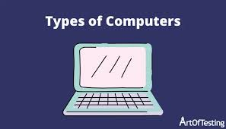
Types Of Computers

Slide 3
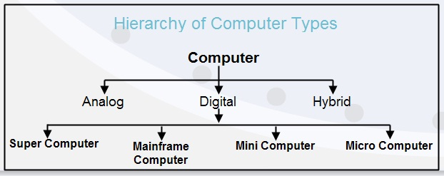

Slide 4
Analog computers
Analog computers use continuous physical magnitudes to represent quantitative information. At first they represented quantities with mechanical components (see differential analyzer and integrator), but after World War II voltages were used; by the 1960s digital computers had largely replaced them. Nonetheless, analog computers, and some hybrid digital-analog systems, continued in use through the 1960s in tasks such as aircraft and spaceflight simulation.

Slide 5
Digital computers
In contrast to analog computers, digital computers represent information in discrete form, generally as sequences of 0s and 1s (binary digits, or bits). The modern era of digital computers began in the late 1930s and early 1940s in the United States, Britain, and Germany. The first devices used switches operated by electromagnets (relays). Their programs were stored on punched paper tape or cards, and they had limited internal data storage. For historical developments, see the section Invention of the modern computer.

Slide 6
Mainframe computer
During the 1950s and ’60s, Unisys (maker of the UNIVAC computer), International Business Machines Corporation (IBM), and other companies made large, expensive computers of increasing power. They were used by major corporations and government research laboratories, typically as the sole computer in the organization. In 1959 the IBM 1401 computer rented for $8,000 per month (early IBM machines were almost always leased rather than sold), and in 1964 the largest IBM S/360 computer cost several million dollars.

Slide 7
Supercomputer
The most powerful computers of the day have typically been called supercomputers. They have historically been very expensive and their use limited to high-priority computations for government-sponsored research, such as nuclear simulations and weather modeling. Today many of the computational techniques of early supercomputers are in common use in PCs. On the other hand, the design of costly, special-purpose processors for supercomputers has been supplanted by the use of large arrays of commodity processors (from several dozen to over 8,000) operating in parallel over a high-speed communications network.

Slide 8
Minicomputer
Although minicomputers date to the early 1950s, the term was introduced in the mid-1960s. Relatively small and inexpensive, minicomputers were typically used in a single department of an organization and often dedicated to one task or shared by a small group. Minicomputers generally had limited computational power, but they had excellent compatibility with various laboratory and industrial devices for collecting and inputting data.
One of the most important manufacturers of minicomputers was Digital Equipment Corporation (DEC) with its Programmed Data Processor (PDP). In 1960 DEC’s PDP-1 sold for $120,000. Five years later its PDP-8 cost $18,000 and became the first widely used minicomputer, with more than 50,000 sold. The DEC PDP-11, introduced in 1970, came in a variety of models, small and cheap enough to control a single manufacturing process and large enough for shared use in university computer centres; more than 650,000 were sold. However, the microcomputer overtook this market in the 1980s.

Slide 9

THANK YOU

